Slide 1
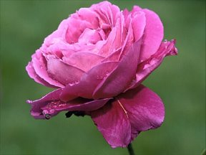

WELCOME

Slide 2

TASLIMA BEGUM
ASSISTANT TEACHER(English)
CHARFESSION T B MODEL HIGH SCHOOL
CHARFASSION, BHOLA.

Slide 3
Class: Nine
Subject: English for today
Unit: Five, Lesson 2
Topic: Environmental pollution
Time: 50 mnts
Date:02.02.2014

Slide 4
Learning outcomes:
By the end of the lesson the Ss will be
Able to
Make question and answer
Take part in role playing and making
Dialogues
Write a paragraph highlighting
Certain problems on environmental pollution

Slide 5
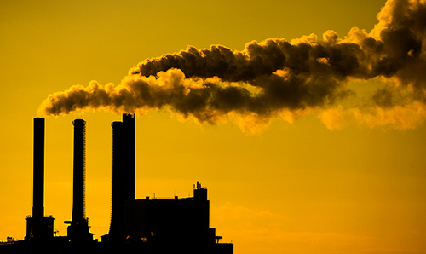
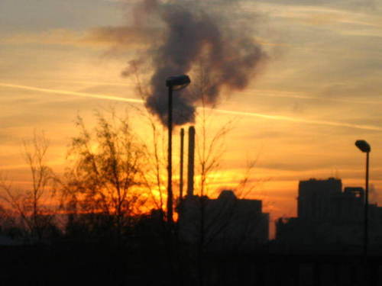
Picture
Picture 1 Picture 2

Slide 6
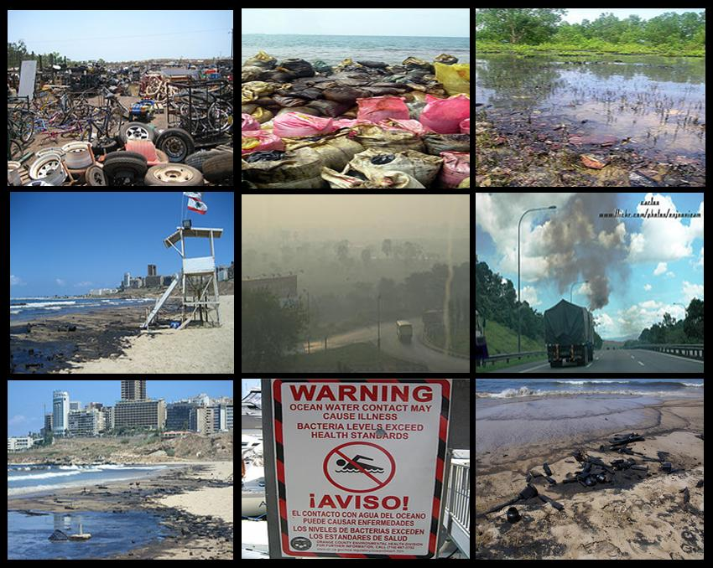
Picture 3

Slide 7
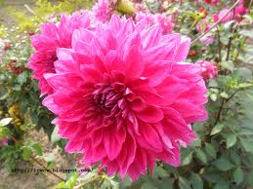

Declaration of the topic:
Environmental pollution

Slide 8
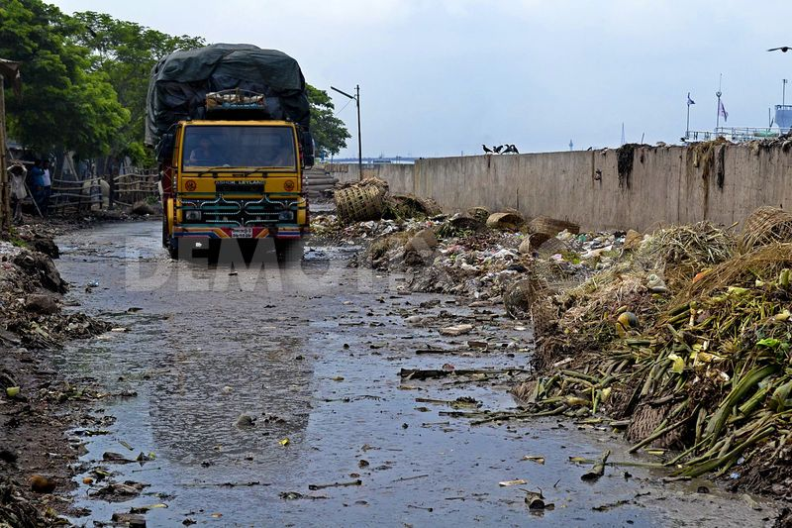
Individual work:
Read the passage to know more about
Environmental Pollution.

Slide 9
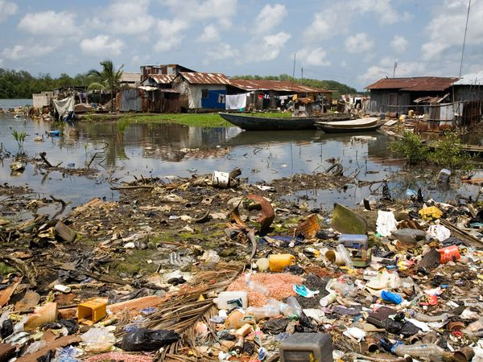
Pair work:
Make five questions on environmental pollution and answer them

Slide 10
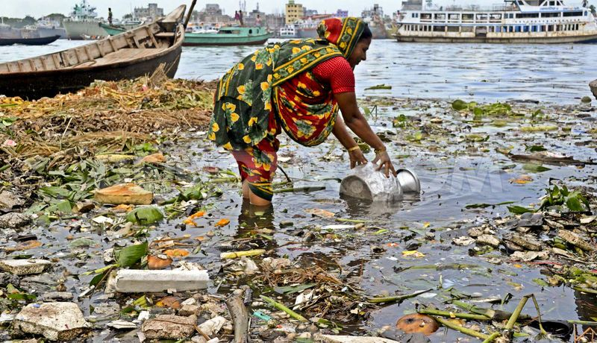
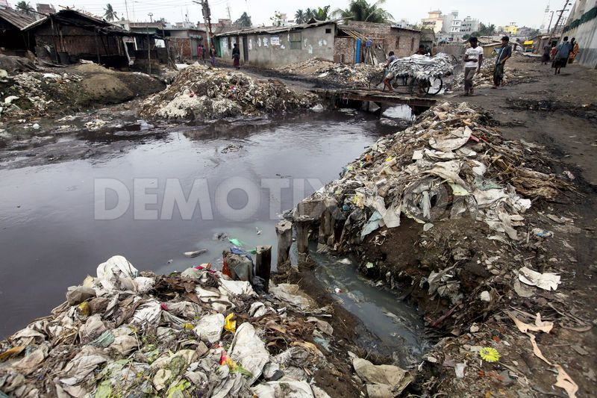
Group work:
Prepare a lecture 80 words on the topic below
Topic: Polluting the land means polluting the water

Slide 11
Evaluation:
What are some of common sources of
Environmental pollution?
Tell two names of another pollution.

Slide 12
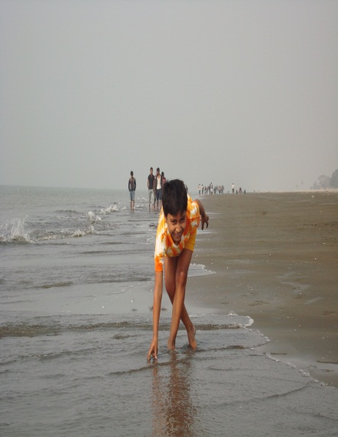
Home work:
Which pollution you have in your area write a paragraph of 60 words on it.

Slide 13

THANKS

